Slide 1
Shape grammar
Compiler Construction

Slide 2
Introduction
Shape grammars in computation are a specific class of production systems that generate geometric shapes. Typically , shapes are 2D or 3D . thus shape grammars are a way to study 2- and 3-dimensional languages. The foundation of shape grammars has been defined in a seminal article by George Stiny and James Gips in 1971.

Slide 3

Formal definition

Slide 4
Stages of shape grammar development
Shapes
Special relations
Shape rules
Derivation

Slide 5
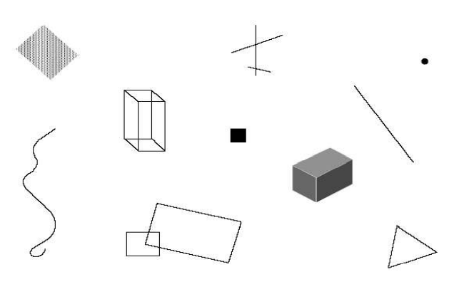
Shapes

Slide 6
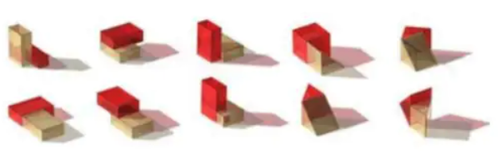
Special relations
Spatial relations constrain the ways that a shape in a vocabulary can be combined with one another. They are simply compositional ideas and are the key to shape grammars. They also provide contexts to adding and subtracting shapes to create designs (Knight 1999b).
Spatial Relation can be achieved using shape grammar

Slide 7
Shape rules
Shape rules are transformations of one shape to another that allow parts of the shapes to be defined and changed recursively to conform to given spatial relationships (Cha and Gero 2001, p.5). Each rule specifies a condition, and associates with that condition an action which may be taken in response.

Slide 8
Shape rules

Slide 9
Derivation
Suppose you have this design:
and you modify it to produce this design:
We can describe the transformation graphically, like this:

Slide 10
Suppose that you want to drive the initial state
to this shape:
What is the grammar 🤔.

Slide 11


Slide 12
Full Example
Shapes
Initial shape
Special relations
Shape rules
Derivation
Shapes
A
B

Slide 13
Initial shape
Special relation
A + B

Slide 14
Final Design
Shape rules

Slide 15
Derivation

Slide 17
Applications
Painting.
Sculpture.
Architecture.
decorative arts.
industrial design and engineering.
Some software prototypes that are available on the web :
Shape Grammar Interpreter Link
Shaper2D Link
Spapper Link
SubShapeDetector Link
Yingzao fashi building generator project Link1 Link2

Slide 18


Thanks for your attention
Questions ?

